Slide 1
Indoor Localization using ML
Prerna Anand
John Adrian Ambrad
Hiranya Maharaja
Deeksha Tewari
Notes:
Prerna: Good Afternoon everyone, today my team and I are going to gives updates on what we have achieved so far with our project on indoor localisation using ML

Slide 2
Team updates
Raspberry Pi
Configured raspberry pis as wifi transmitters
Changed project scope to configure phone and laptop as receivers
Began raw data collection on Bahen 8th floor
Comparing raw data and RayTracer data
Raytracer
Simulated data points throughout the map for training and testing data
Performed Converge Analysis
Simulated data for 3 different access points using the RayTracer
Data cleanup
Nearest Neighbors Algorithm
Used sklearn nearest neighbours’ to output the possible neighbors given three RSSI
Evaluate generalization using custom method
Notes:
Prerna:
We have worked on three aspects of the project. The team split into two and parallely worked on collecting the Raspberry Pi and RayTracer data. We were successfully able to collect accurate rtr data and our still working on finalizing the rpi data.
For proof of concept, we trained sklearn’s nearest neighbors algorithms with the rt dataset to evaluate how well it generalizes

Slide 3
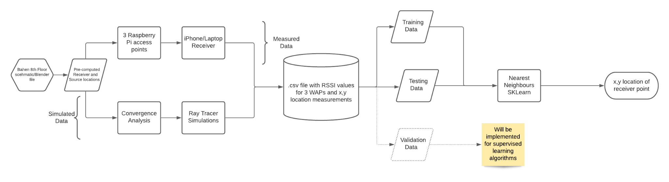
System Context Diagram
Notes:
Deeksha -
Illustrates our workflow and process
Rpis were configured with openWRT. For the most part they were configured correctly, but as you will see later, we might have to review some of the settings of the Raspberry pis.
Talks about the various data collections methods, NN model, and prediction.

Slide 4
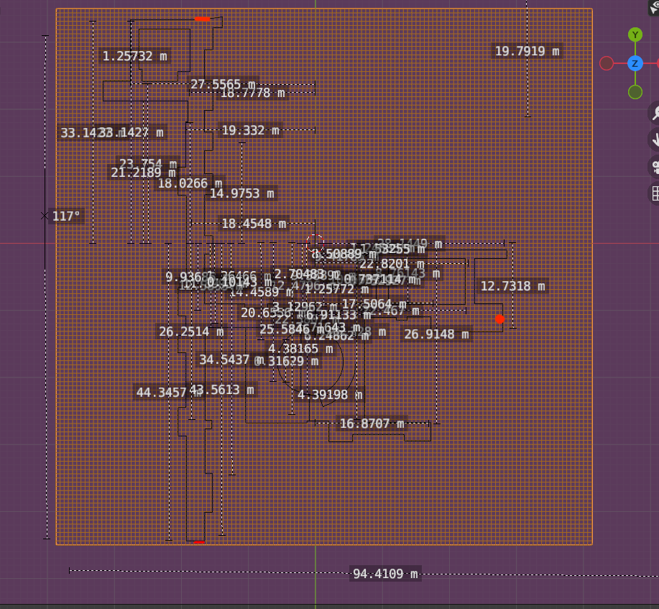
Raspberry Pi - Data collection method
Configured raspberry pis with openWRT software
Set up an RPi transmitter in the specified locations
Measured the distance of the collection points with tape on the floor
Used a laptop configured with NetSpot (open source) software to measure wifi signal strength (RSSI value)
Record RSSI value and the corresponding distance it was measured at
Figure 1: Location of Transmitter points on Bahen blender map
Notes:
Deeksha and John
Add one picture of the bahen eighth floor with the location that we started at as well as a table displaying the distances we were working at and the RSSis
Script - Currently, we have configured three raspberry pis to act as transmitters using openWRT software. We plan to capture at least 300 hundred data points by january to use in our upgraded models. We have rpi transmitters set up in three locations as three sources, to get more generalisability in our results. We will try to make the same measurements as the raytracer, and also take some random measurements on the 8th floor to add more diversity to our data set.

Slide 5
X | Y | Strength
3.7 | 5 | -42
-1.5 | 17 | -50
9 | 27 | -50
-4.5 | 36 | -52
1.5 | 70 | -58
1.5 | 90 | -62
4.5 | 160 | -63
-4.5 | 170 | -71
-7.5 | 170 | -75
Table of RSSI value strengths and the distance at which they were recorded
Notes:
Deeksha and John:
The x and y locations listed here were recorded with respect to the raspberry pi transmitter as an origin point. This was to ensure that we could get the model to predict the location of the receiver as a relative value to the source, to ensure consistency across the plane.
We note that the strength does decrease as we move away from the transmitter (the Y measurement). However, there is a mismatch in the values seen for the receiver being very close to the transmitter and further away. We are going to have to reconfigure the openWRT software to ensure that we are only emitting wifi signals within a specific range of strengths.

Slide 6
RayTracer Data Collection
Simulated 2657 training data points by collecting points at intervals of 0.5 feet in the x and y directions using a map of Bahen’s 8th floor
Simulated 592 testing points by using intervals of 0.7 and 1.7 in the x and y directions on the map
Collected data for reflections within [1,5] for one access point and performed a convergence analysis
Ideal # of reflections = 2
Ideal # of diffractions = 1
Obtained RSSI for 3 different access points in both datasets
Created csv files for both datasets
Notes:
Prerna:
We started RayTracer data collection by first simulating the data points. For the training data set we did it in intervals of 0.5 ft in both x and y direction and for the testing data set we did it in intervals of 0.7 in x direction and 1.7 in y direction.
After getting the data points, We collected data for one access point with the number of reflections in the range of 1-5. We performed a convergence analysis on this data to determined 2 as the ideal number of reflections.
Finally, we ran the raytracer for the 3 different access points to obtain all RSSI values and created respective csv files for each dataset.

Slide 7
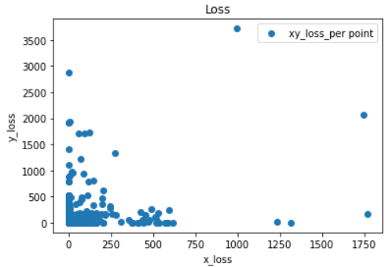
Nearest Neighbors
Used scikit-learn’s Nearest Neighbors implementation for Proof of Concept
Analysed 10 nearest neighbors for each testing data point
Defined mean squared loss for each prediction
Notes:
Hiranya
As a proof of concept, we fit our training set to the nearest neighbours model provided by sklearn. When called with the test data, this model outputs a specified number of neighbors corresponding to the input signals. I.e, it outputs possible values closest to the target location. We decided to group the outputs into cloisters that are within 2m of each other, and then take the mean of the longest resulting array (i.e the value that is closest to most of the neighbors), and then plot a mean squared loss for it. This method does well sometimes and does badly other times, meaning we can improve our accuracy by substituting the sklearn model for our own custom architecture going forward.

Slide 8
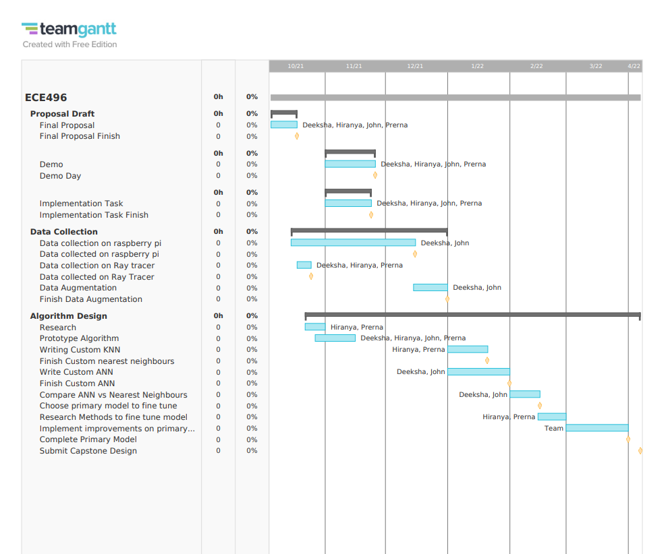
Gantt chart
Notes:
Hiranya
We just talked about what we did, this chart shows what we will do until the end of the year
Continue splitting into subteams - deeksha and john will finish data collection while prerna and I finish the KNN model, then theyll implement an ANN then we choose final model in march to tune

Slide 9
Thanks!
Any questions?
Notes:
John

